Slide 1


SUPPLY CHAIN MANAGEMENT NAVIGATOR
A TABLEAU DASHBOARD FOR SUPPLY CHAIN PROFITABILITY AND INVENTORY MANAGEMENT
PRESENTED BY : MAHIM KANOJIA

Slide 2


CONTENTS
1
5
INVENTORY OVERVIEW
AGENDA
2
STEPS TAKEN IN PROJECT
6
INSIGHTS
3
7
STATISTICS
RECOMMENDATIONS
4
PROFIT AND SALES SUMMARY

Slide 3
AGENDA
Develop a comprehensive grasp of supply chain management, particularly as it relates to handling extensive datasets, while simultaneously analyzing sales and profit trends on a global scale.
Our objective was to identify key performance metrics that reveal the interrelationships between diverse data elements, enabling a deeper understanding of their collective impact.
Additionally, we sought to acquire expertise in inventory management strategies to optimize resource allocation and minimize costs.

Slide 4
STEPS TAKEN IN PROJECT
GATHERING AND ANALYZING DATA
Data Extraction: To provide a baseline dataset for further research, the project started by extracting crucial order and shipment, warehouse inventory, and fulfillment data from CSV files.
Data Cleaning: A thorough cleaning procedure was put in place to get rid of errors and inconsistencies and improve the quality of the data to guarantee its accuracy and dependability.
Data Refinement: In order to expedite the study and concentrate on important factors that greatly contribute to the project objectives, irrelevant features were systematically omitted.

Slide 5
STEPS TAKEN IN PROJECT
ANALYZING AND VISUALIZING DATA
Metric Calculation: To derive significant insights and spot patterns in the sales and inventory data, key performance indicators were calculated from the improved information.
Interactive Visualization: By utilizing Tableau's strong visualization features, dynamic and interactive graphs and charts were produced, which successfully explained intricate data patterns to the audience.
Dashboard Development: A thorough dashboard offering a comprehensive view of the sales and profit performance as well as inventory dynamics was meticulously developed by carefully choosing and arranging different chart types.

Slide 6

STATISTICS
$ 6.1 M +
$ 2.2 M +
30 K +
TOTAL SALES
TOTAL PROFIT
TOTAL ORDERS
100 +
130 +
PRODUCTS
TOTAL COUNTRIES

Slide 7
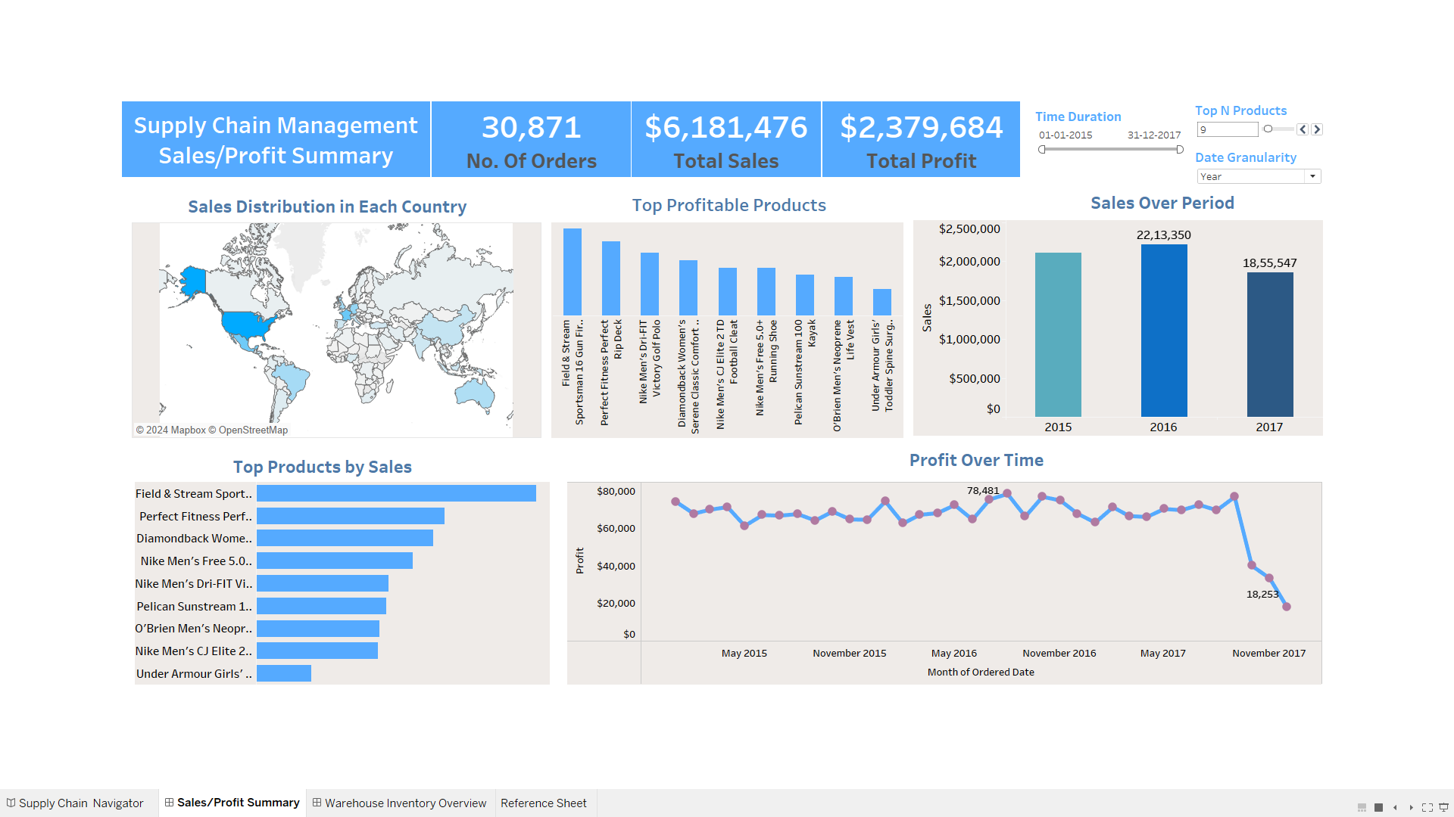
Profit and Sales Summary Dashboard

Slide 8
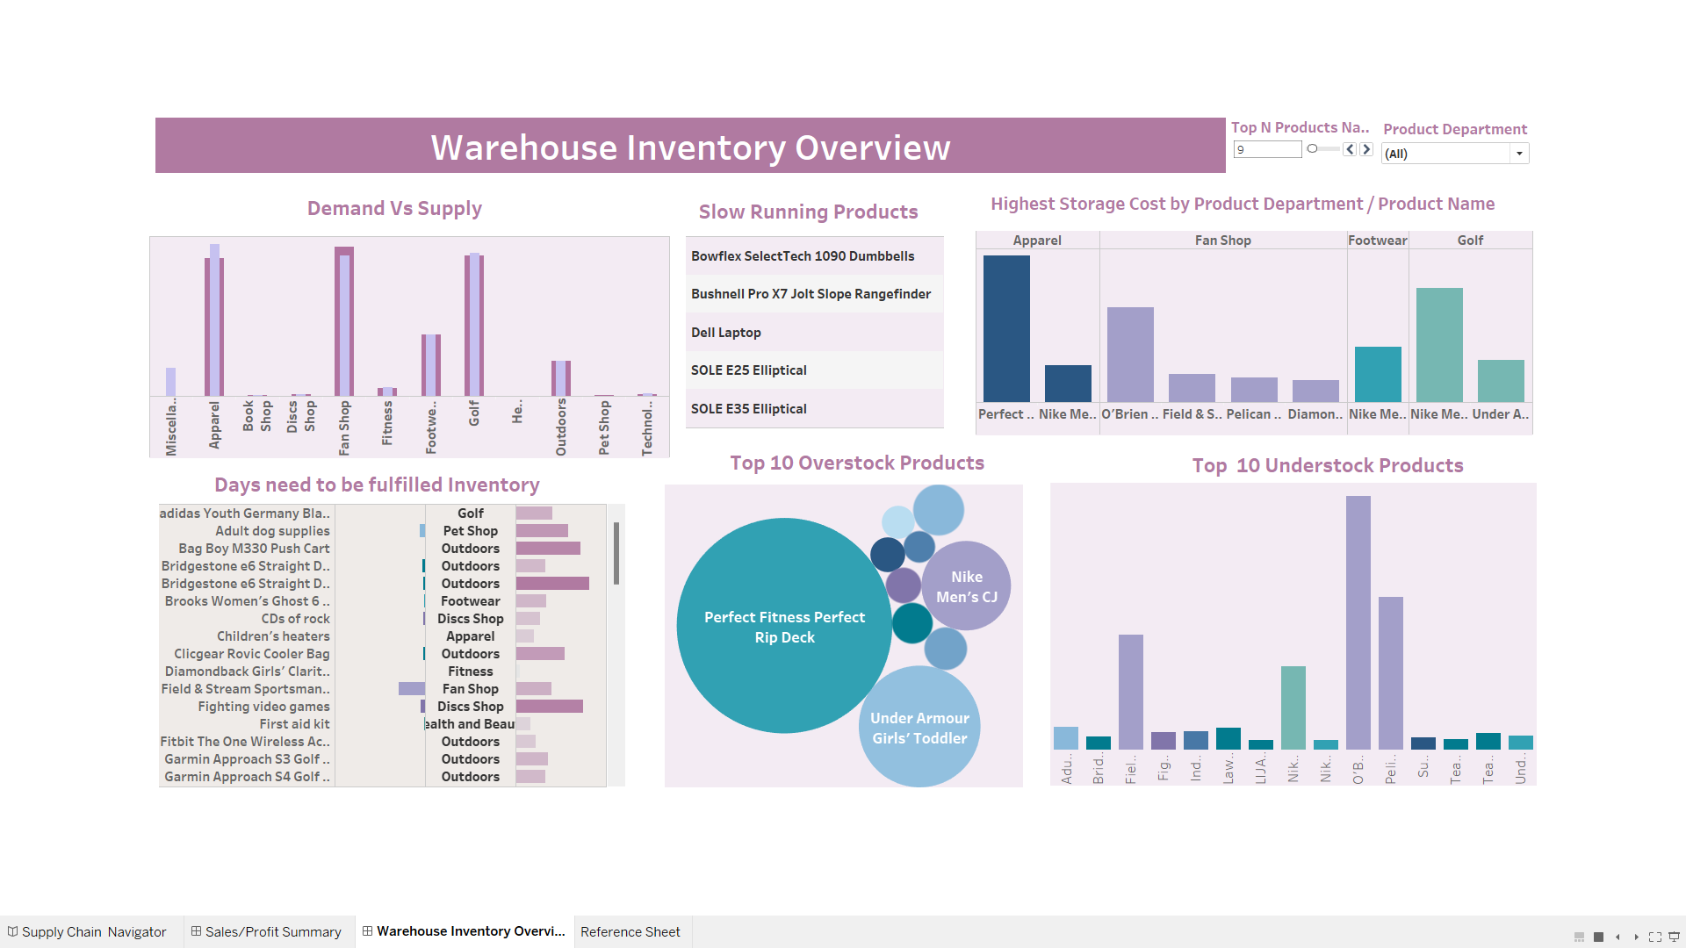
Warehouse Inventory Overview Dashboard

Slide 9
INSIGHTS
The United States emerged as the undisputed global leader in both sales volume with $865,442 and profitability of $333,162, with France and Mexico trailing behind.
2016 generated the highest sales of $2,213,350.
A trend analysis painted a concerning picture, revealing a sharp decline in sales following the peak of 2016. This downward trajectory was particularly pronounced in the 2017 Q4 comes to $ 227,488.
Among the various product departments, Fan Shop , Apparels emerged as the top performer, consistently generating the highest sales figures and profit as well. Conversely, book sales yielded the least amount of revenue.

Slide 10
INSIGHTS
Demand for certain products, such as laptops, dumbbells, and elliptical remains relatively very low compared to other items in the inventory.
On average, it takes slightly over 5 days to replenish warehouse stock levels. The associated average storage cost per item amounts to $20.58.
To ensure uninterrupted supply and prevent potential stockouts, it is crucial to increase the inventory levels within the fan shop department to align with the current high demand.
While Apparel and fan shop incur the most significant storage expenses, items stocked in the pet shop and health and beauty sections generate the lowest storage costs.

Slide 11
RECOMMENDATIONS
Implement robust demand forecasting models to accurately predict product demand, especially for high-selling department like fan shop and apparel. This will help in avoiding stockouts and overstocking.
Explore opportunities to reduce storage costs, especially for low-demand items like laptops and dumbbells. Consider alternative storage solutions or renegotiating warehouse contracts.
Analyze transportation costs and routes to identify opportunities for savings. Consider consolidating shipments or exploring alternative transportation modes.
Work with suppliers to reduce lead times for critical products. This will improve responsiveness to demand fluctuations and reduce the risk of stockouts..

Slide 12
RECOMMENDATIONS
Track the lifecycle of different products to identify trends and adjust inventory levels accordingly. Phase out low-demand products and introduce new products based on market demand.
Analyze the profitability of different product categories. Focus on maximizing the profitability of high-margin products while managing inventory levels for low-margin items.
Expand the horizon by creating more demand in other location such as South Asia , Middle East and Africa region which can give higher profit in future.

Slide 13
THANK YOU
EMAIL ID : KANOJIAMAHIM78@GMAIL.COM
LINKEDIN PROFILE : CLICK HERE
TABLEAU DASBOARD- CLICK HERE

